Slide 1
Secure Programming
程式安全
Chap2: Introduction to Static Analysis
Capabilities and Limitations of Static Analysis
Solving Problems with Static Analysis
A Little Theory, a Little Reality
Summary

Slide 2
Capabilities and Limitations of Static Analysis
False Positives
  Problem reported but not actually exists (false alarm)
  Not Sound
False Negatives
  Problem exists but not reported
  Not Complete
Code Quality Tool
  Low false positives and accept false negatives
Software Security
  More false positives to minimize false negatives

Slide 3
Solving Problems with Static Analysis
Type Checking
Style Checking
Program Understanding
Program Verification
Property Checking
Bug Finding
Security Review

Slide 4


Type Checking
False Positive
False Negative
10 short s = 0; 11 int i = s; /* the type checker allows this */ 12 short r = i; /* false positive: this will cause a 13 type checking error at compile time */
$ javac bar.java bar.java:12: possible loss of precision found : int required: short short r = i; /* false positive: this will cause a ^ 1 error
Object[] objs = new String[1]; objs[0] = new Object();
  Type checker won’t complain, but when code runs, it throws an ArrayStoreException.

Slide 5
Style Checking
Rules on
  Whitespace, naming, deprecated functions, commenting, program structure
Examples
  gcc –Wall
  lint
  lint-like
    PMD (style checking java)
    Parasoft (Java, C, and C++)

Slide 6
C function with a switch statement
1 typedef enum { red, green, blue } Color;
2
3 char* getColorString(Color c) {
4 char* ret = NULL;
5 switch (c) {
6 case red:
7 printf("red");
8 }
9 return ret;
10 }
The output from gcc using the -Wall flag.
  enum.c:5: warning: enumeration value 'green' not handled in switch
  enum.c:5: warning: enumeration value 'blue' not handled in switch

Slide 7
Program Understanding
Reverse Engineering higher-level information from lower-level source
  Reversing design from implementation
  Find all use of the method
  Find the declaration of this global variable
Example: Fujava
  Move back and forth between UML and Java source code
  Infer design patterns from the source code
Example: CAST
  http://www.castsoftware.com
  Cataloging and exploring large systems

Slide 8
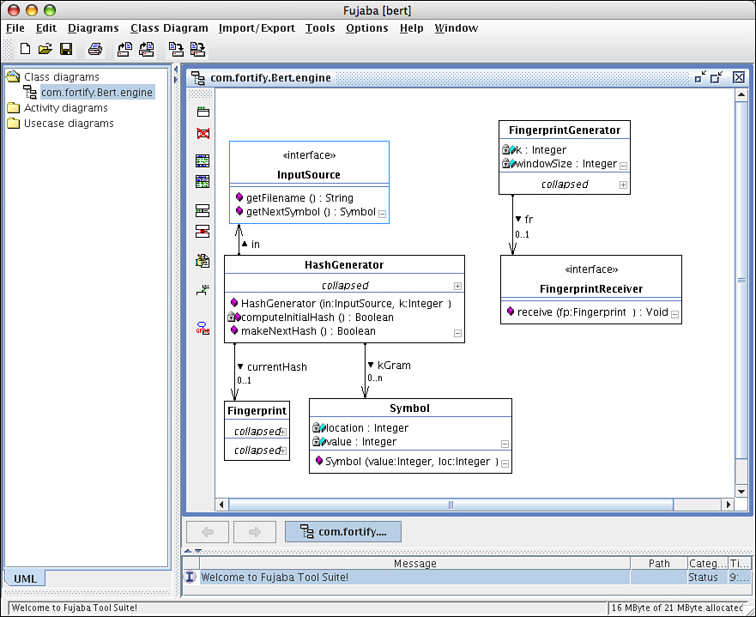

Slide 9
Program Verification and Property Checking
Complete Specification for Program Verification
  A Specification
  An Implementation
  Equivalence checking: Implementation and Specification exactly match
Partial Specification for Property Checking
  A property (partial specification)
  A Model (abstraction of the Implementation)
  Model Checking: check if the model satisfies the property
    Or report a counterexample

Slide 10
Property Checking
Temporal Safety Properties
  An ordered sequence of events that a program must not carry out
  Example: A memory location should not read after it is freed
Counterexample
  A hypothetical event or sequence of events
  Lead to the property being violated

Slide 11
A Memory Leak
If the first call to malloc() succeeds and the second fails, the memory allocated in the first call is leaked.
1 inBuf = (char*) malloc(bufSz);
2 if (inBuf == NULL)
3 return -1;
4 outBuf = (char*) malloc(bufSz);
5 if (outBuf == NULL)
6 return -1;
A Counterexample
Violation of property "allocated memory should always be freed":
  line 2: inBuf != NULL
  line 5: outBuf == NULL
  line 6: function returns (-1) without freeing inBuf
An errant Counterexample
Violation of property "allocated memory should always be freed":
  line 2: inBuf == NULL
  line 3: function returns (-1) without freeing inBuf

Slide 12
Program Verification Systems
Praxis High Integrity Systems
  http://www.praxis-his.com
  for the Ada programming
Escher Technologies
  http://www.eschertech.com
Poly-space
  http://www.polyspace.com
Grammatech
  http://www.gramatech.com
More in Chapter 4 (MOPS, Splint, SLAM, BLAST,…)

Slide 13
Bug Finding
Tool with bug idioms (rules) that describe patterns in code that often indicate bugs
Ideal bug finding tool
  Sound w.r.t. A counterexample
  The bug report is a feasible sequence of events in the program

Slide 14
Double-checked locking
To minimize synchronization while guaranteeing that only one object will ever be allocated
1 if (this.fitz == null) {
2 synchronized (this) {
3 if (this.fitz == null) {
4 this.fitz = new Fitzer();
5 }
6 }
7 }
FindBugs identifies the double-checked locking idiom.
M M DC: Possible doublecheck on Fizz.fitz in Fizz.getFitz()
At Fizz.java:[lines 1-3]

Slide 15
Why Double-Checked Locking Broken
// Single threaded version
class Foo {
private Helper helper = null;
public Helper getHelper() {
if (helper == null)
helper = new Helper();
return helper; }
// other functions and members... }
// Correct but possibly expensive multithreaded version
class Foo {
private Helper helper = null;
public synchronized Helper getHelper() {
if (helper == null)
helper = new Helper();
return helper; }
// other functions and members... }
Perform synchronization everytime getHelper() called

Slide 16
Broken version of double-checked locking
// Broken multithreaded version // "Double-Checked Locking" idiom
class Foo {
private Helper helper = null;
public Helper getHelper() {
if (helper == null) { synchronized(this) {
if (helper == null) {
helper = new Helper();
} } }
return helper; }
// other functions and members... }
Check if initialized
Obtain Lock
Double check if initialized
Otherwise, initialized and return

Slide 17
Issues about the double-checked locking
Thread A find the variable uninitialized, obtain the lock, and try to initialize the variable
Thread B find the variable initialized and return it
If before thread A complete the initialization, and the variable returned by thread B is used, the program may crash

Slide 18
Revision for J2SE 5.0
// Works with acquire/release semantics for volatile
// Broken under Java 1.4 and earlier semantics for volatile
class Foo {
private volatile Helper helper = null;
public Helper getHelper() {
if (helper == null) {
synchronized(this) {
if (helper == null)
helper = new Helper();
} }
return helper; }
// other functions and members... }

Slide 19
Security Review (static analysis tools specifically for security)
Former Security tools
  Grep, ITS4, Flawfinder
  Closely related to style-checkers
  High rate of false positives
Current Development: a hybrid of property checkers and bug finder
  Security Properties as program properties
  Example
    Searching for potential buffer overflow vulnerabilities
    Checking the property “The program does not access an address outside the bounds of allocated memory”

Slide 20
Security check to strcpy()
A good tool should categorize
  the first call as safe
  the second call as dangerous.
int main(int argc, char* argv[]) {
char buf1[1024];
char buf2[1024];
char* shortString = "a short string";
strcpy(buf1, shortString); /* safe use of strcpy */
strcpy(buf2, argv[0]); /* dangerous use of strcpy */
…

Slide 21
Dangerous argv[0]
Under filesystem with symbolic links
  Attacker can make A symbolic link to a program
  argv[0] will be the name of the symbolic link
POSIX
  execl() as a wrapper
  Attacker can specify a value for argv[0]
More in chapter 12 for a privileged program

Slide 22
Examples
Fortify Software
  http://www.fortify.com
Ounce Labs
  http://www.ouncelabs.com

Slide 23
A Little Theory, a Little Reality
Success Criteria
Source vs. Compiled Code

Slide 24
Computationally Undecidable
Undecidability
  Alan Turing in mid-1930s
  Algorithms cannot be used to solve all problems
  Halting problem: the problem of determine whether a given algorithm terminates (reach a final state)
Halting problem
  No way to know what an algorithm will do
  Only way is to run it
  If an algorithm does not terminate, a decision about whether the algorithm terminates will never be reached
Using one algorithm to analyze another

Slide 25
Rice’s theorem (1953)
Static analysis cannot perfectly determine any nontrivial property of a general program
if program p halts
  call unsafe()
To decide if the program call unsafe(), a static analysis tool must solve the halting problem

Slide 26
Limitation of all static analysis tools
Static Analysis tool (like is_safe())
  A program
  Take a program as an argument
  Return true if the program is safe
  Return false if the program is not safe
Perfectly determining any nontrivial program property is impossible in the general case
bother(function f) {
if ( is_safe(f) )
call unsafe();
}
b = bother;
bother(b);

Slide 27
A contradiction of is_safe()
Assume is_safe() is safe (and unsafe() is not safe())
If is_safe() determins bother is safe, bother will call unsafe()
If is_safe() determines bother is unsafe, bother will not call unsafe() and it is safe
Both cases lead to a contradiction
bother(function f) {
if ( is_safe(f) )
call unsafe();
}
b = bother;
bother(b);

Slide 28
The Implication and the Success Criteria
Static analysis tools may produce at least some false positives or false negatives
Making Sense of the Program
Trade-Offs Between Precision, Depth, and Scalability
Finding the Right Stuff
Ease of Use

Slide 29
Making Sense of the Program
Ascribing meaning to source code: semantic analysis
  Making sense of the program text
  Understanding the libraries the program uses
  How the components fit together
Challenges
  Own language dialects with new syntax
  Ambiguous language specifications
  C tortures
Steps to make sense
  Code Parsing
  Effects of library or system calls
  Modeling the behavior of library and system functions

Slide 30
More Challenges of Static Analysis
Quality of library characterizations
Multiple language modules with different programming languages
Environment aspects
  Program’s configuration information

Slide 31
Trade-Offs: Precision, Depth, and Scalability
Precision and Scalability
  Sacrifice precision for better scalability, Or
  Focus on finding better trade-offs
Depth
  Amount of the program that the tool examines at one time
  Different depths: An entire system, an entire program, a module, individual functions

Slide 32
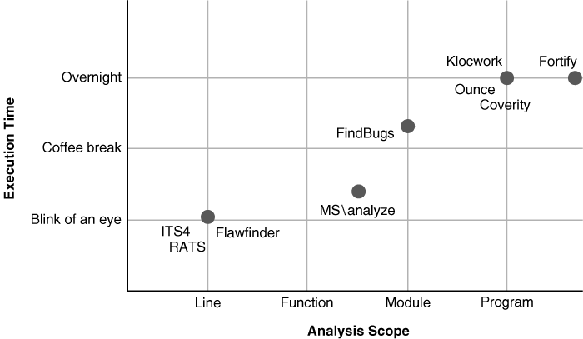
Analysis Scope vs. Execution Time (for bug finding)

Slide 33
Finding the Right Stuff
Clients fail differently than servers
OS systems fail differently than desktop applications
Static Analysis Benchmarks
  Benjamin Livshits
    SecuriBench: Web-based Java programs with known security defects
    SecuriBench Micro: A set of small hand-crafted Java Programs (stress different aspects of a static analysis tool)
  Zitser, Lippman and Leek
    Collection of vulnerable programs from real-world vulnerable programs
  Kratkiewicz
    A set of scripts to generate vulnerable program with different characteristics

Slide 34
More Benchmarks
SAMATE group at NIST
  Publicly available reference data for benchmarking static analysis tools
ABM (Analyzer Benchmark): Tim Newsham and Brian Chess
  Hand-crafted programs and large real-world programs for characterizing static analysis tool (integrated to SAMATE)
Department of Homeland Security’s Build Security In site
  Sample programs by Cigital for evaluating static analysis tools
Difficulties
  How to measure Trade-offs between false positives and false negatives
  Bench the system you understand well

Slide 35
Ease of Use
Present Good Error Information
Allow to suppress false positives
Fit in as part of the software development process
Finding the needed source code to make sense of the code
  Integrate smoothly with the build system

Slide 36
Source or Compiled Code Analysis
Advantages of Compiled Code
  Removing the ambiguity (compiler has done the job)
  Source Code hard to be obtained
Disadvantages of Compiled Code
  Semantic analysis (make sense of the program) is hard for compiled code
    No type information
    Use dynamic analysis tool like IDA Pro
    Optimization by the compiler
    Three lines of JSP into more than 50 lines of Java source
  Error Reporting in binary code may not be useful
    Unless with debugging information

Slide 37
Java Server Page (JSP) and Java Code
if (_fmt_message0 == null)
_fmt_message0 =
new org.apache.taglibs.standard.tag.el.fmt.
MessageTag_fmt_message0.setPageContext(pageContext);
_fmt_message0.setParent((javax.servlet.jsp.tagext.Tag)null);
_activeTag = _fmt_message0;
_fmt_message0.setKey(
weblogic.utils.StringUtils.valueOf("hello"));
_int0 = _fmt_message0.doStartTag();
if (_int0 != Tag.SKIP_BODY) {
if (_int0 == BodyTag.EVAL_BODY_BUFFERED) {
out = pageContext.pushBody();
_fmt_message0.setBodyContent((BodyContent)out);
_fmt_message0.doInitBody();
}
do {
out.print("\r\n ");
if (_fmt_param0 == null)
_fmt_param0 =
new org.apache.taglibs.standard.tag.el.fmt.ParamTag();
_fmt_param0.setPageContext(pageContext);
_fmt_param0.setParent(
(javax.servlet.jsp.tagext.Tag)_fmt_message0);
_activeTag = _fmt_param0;
_fmt_param0.setValue(
_fmt_param0.setValue(
weblogic.utils.StringUtils.valueOf("${param.test}"));
_int1 = _fmt_param0.doStartTag();
weblogic.servlet.jsp.StandardTagLib.fakeEmptyBodyTag(
pageContext, _fmt_param0, _int1, true);
if (_fmt_param0.doEndTag() == Tag.SKIP_PAGE) {
_activeTag = null;
_releaseTags(_fmt_param0);
return;
}
_activeTag = _fmt_param0.getParent();
_fmt_param0.release();
out.print("\r\n ");
Summary 45
} while ( _fmt_message0.doAfterBody() ==
IterationTag.EVAL_BODY_AGAIN);
if (_int0 == BodyTag.EVAL_BODY_BUFFERED)
out = pageContext.popBody();
}
if (_fmt_message0.doEndTag() == Tag.SKIP_PAGE) {
_activeTag = null;
_releaseTags(_fmt_message0);
return;
}
_activeTag = _fmt_message0.getParent();
_fmt_message0.release();
_writeText(response, out, _wl_block2, _wl_block2Bytes);
if (_fmt_message0 == null)
_fmt_message0 =
new org.apache.taglibs.standard.tag.el.fmt.MessageTag();
Echo the value of a URL parameter (a cross-site scripting vulnerability).
<fmt:message key="hello">
<fmt:param value="${param.test}"/>
</fmt:message>

Slide 38
Static analysis tools discussed
Type of Tool/Vendors | Web Site
Style Checking
PMD | http://pmd.sourceforge.net
Parasoft | http://www.parasoft.com
Program Understanding
Fujaba | http://wwwcs.uni-paderborn.de/cs/fujaba/
CAST | http://www.castsoftware.com
Program Verification
Praxis High Integrity Systems | http://www.praxis-his.com
Escher Technologies | http://www.eschertech.com
Property Checking
Polyspace | http://www.polyspace.com
Grammatech | http://www.gramatech.com
Bug Finding
FindBugs | http://www.findbugs.org
Coverity | http://www.coverity.com
Visual Studio 2005 \analyze | http://msdn.microsoft.com/vstudio/
Klocwork | http://www.klocwork.com
Security Review
Fortify Software | http://www.fortify.com
Ounce Labs | http://www.ouncelabs.com

Slide 39
Summary
Making sense of the program (building an accurate program model)
Making good trade-offs between precision, depth, and scalability
Looking for the right set of defects
Presenting easy-to-understand results and errors
Integrating easily with the build system and integrated development environments

